Slide 1

Water Pump Predictions
Team : Hydro Dominion
Contributors :
Vaibhav Koneti
Issac
Blessing

Slide 2
Hypothesis
Is this data good enough to use?
Pump Type Influences Functional Lifespan and Maintenance Reliability ?
Does a bigger crowd mean more breakages?
Does having a management keep the water flowing?

Slide 3
Dataset Overview and Preparation
Dataset Information: Contains 59,400 rows and 41 columns.
Target Variable: Categorized into functional, non-functional
and functional needs repair.
Updated Dataset: Reduced to 59,400 rows and 31 columns
after preprocessing.
Grouping the Dataset: Based on location, technical characteristics of pumps, maintainer and demand.

Slide 4
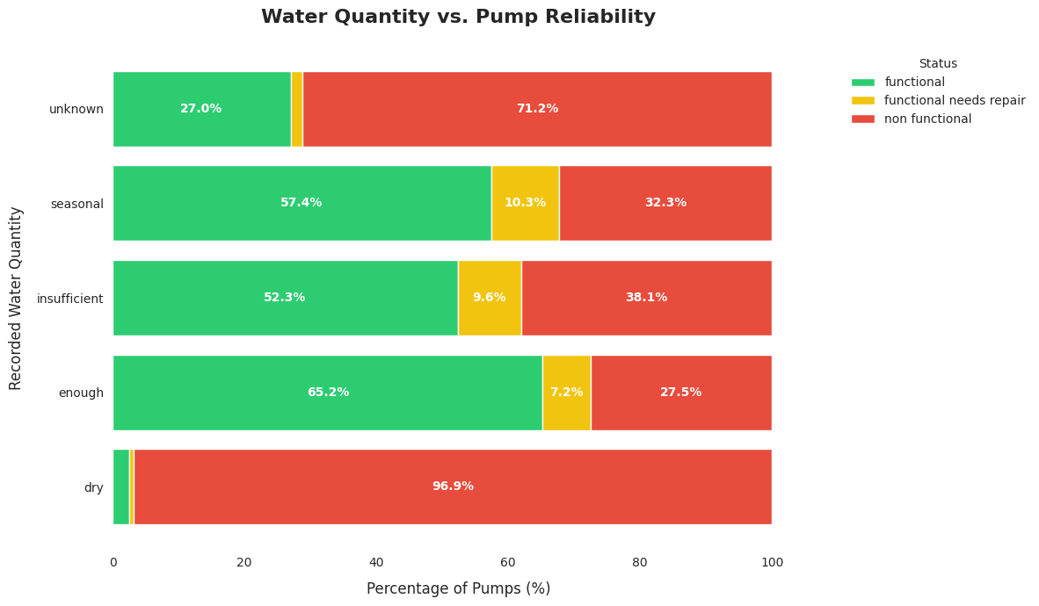
Is this data good enough to use?
When water sources are "dry," nearly 97% of pumps become non-functional.
Pumps with "enough" water maintain the highest success rate, with over 65% remaining fully operational.

Slide 5
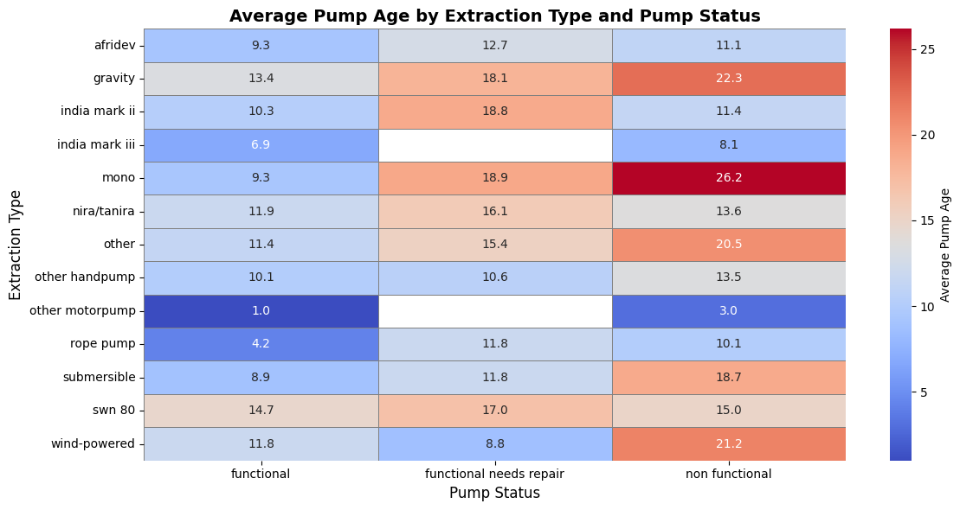
Pump Type Influences Lifespan and Maintenance
Mono, gravity, and wind pumps last longer and stay functional more often.
Handpumps and rope pumps fail and have shorter life.
Wind, submersible, mono can still work well if repaired regularly.

Slide 6
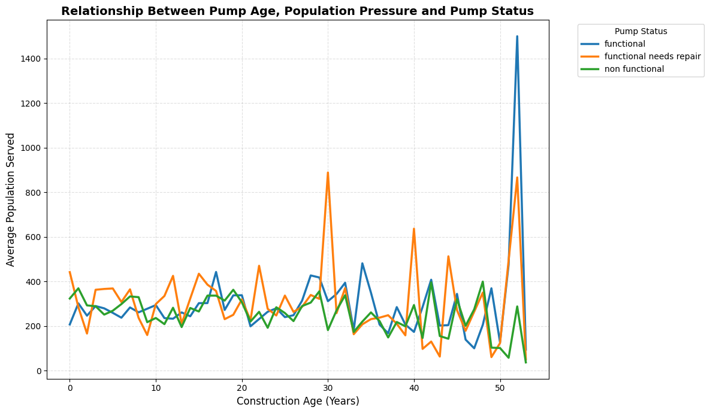
Does a bigger crowd mean more breakages?
Pump failure is not strongly linked population served — all three statuses show similar patterns across most years.
Older pumps 50 plus years are unpredictable. they show sudden spikes, signaling higher infrastructure risk.

Slide 7
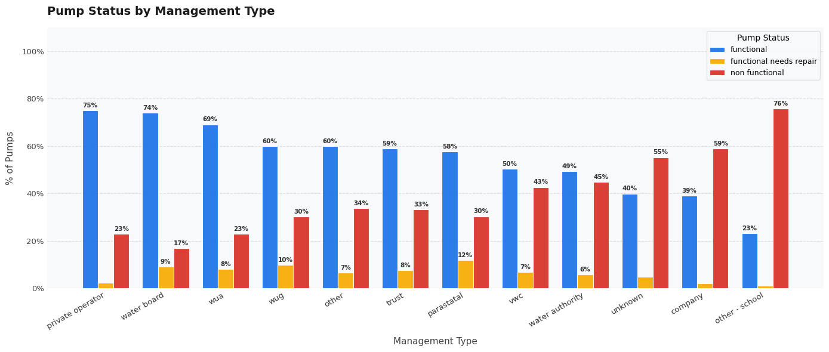
Does having a management keep the water flowing?
Professional managers (private operator, water board, WUA) keep 70% over of pumps running.
Schools and companies have the highest failure rates — likely NGO-run with no structured maintenance.
The better organized the management, the lower the failure rate.

Slide 8

Retrospective
Exploring the data iteratively gave us a deeper understanding during EDA
Lack of communication early on caused confusion
Maintain consistent communication stays aligned and clear on goals.

Slide 9
Thanks a lot!

